Slide 1

CPM – Compounded Pharmaceutical
A system that lets you buy drugs at cheaper cost
Ketan Malik
NUID - 001378783

Slide 2
Problem Statement
To design a pharmaceutical application addressing the ever-ricing prices of medicines in the market
The application provides an alternative formulation to selected drugs at a cheaper rate because it eliminates the various middle-man involved between the manufacturing and retailing process of medicines
To provide a platform to doctors where they can raise a ‘research request’ to the compound pharmacy enterprise requesting to device a suitable formulation for a medicine
To provide a platform to doctors and patients where they can order a cheaper formulation of the existing medicine from the list

Slide 3
Architecture
1. Ecosystem – Consists of a Network
2. Network – Consists of two enterprise
Compound Pharmacy Enterprise: Manages manufacturing/research, inspection and delivery of formulation
Marketing Enterprise: Manages advertising of newly accepted formulations and adds doctors and patients for requesting manufacturing/research
3. Compound Pharmacy Enterprise – Consists of 4 organizations
Manufacture Organization
Research Organization
Inspection Organization
Delivery Organization
4. Marketing Enterprise – Consists of 3 organizations
Advertising Organization
Doctor Organization
Patient Organization

Slide 4
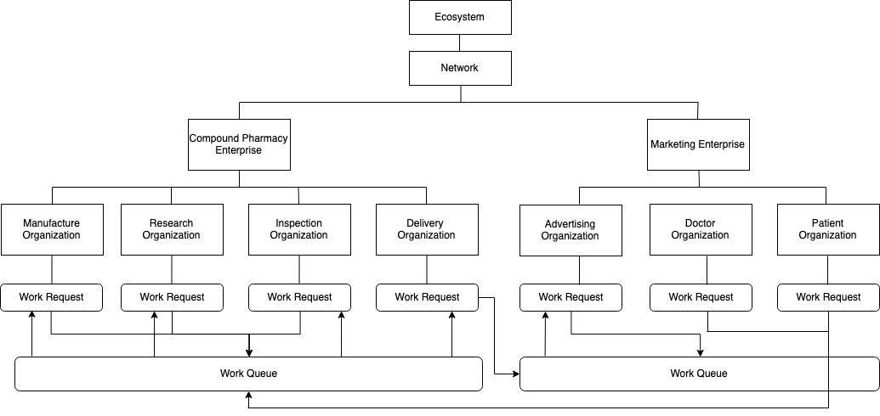

Slide 5
Application Features
1. Ecosystem Admin
Create, update and view network
Add enterprises under network
Create employees under enterprise and provide login credentials and enterprise admin privileges
2. Enterprise Admin
Create, update and view organizations
Add employees under organizations and add their respective user accounts for providing login priviledges
View following pie charts:
Employee-Organization distribution
Organization-Work Request distribution
Medicine-Manufacturing Distribution
Medicine-Research Distribution
State-wise manufacturing request
State-wise research request

Slide 6
Application Features Cont..
3. Organization Employees
Doctor Role – create work request for either manufacture/research a medicine
Patient Role – create work request for manufacturing a medicine
Manufacturing Role – accept a manufacturing W.R. and process for inspection
Research Role – accept a research W.R. and process for inspection
Inspection Role – accept an inspection W.R. and either process further for delivery/advertising or send it back to manufacture/research organization
Delivery Role – accept a delivery W.R. and process for pickup. Send SMS with pickup code to the originator once the request is processed
Advertising Role – accept an advertising W.R. and process for marketing. Once processed, an SMS is sent to originator and the medicine is made available for ordering

Slide 7
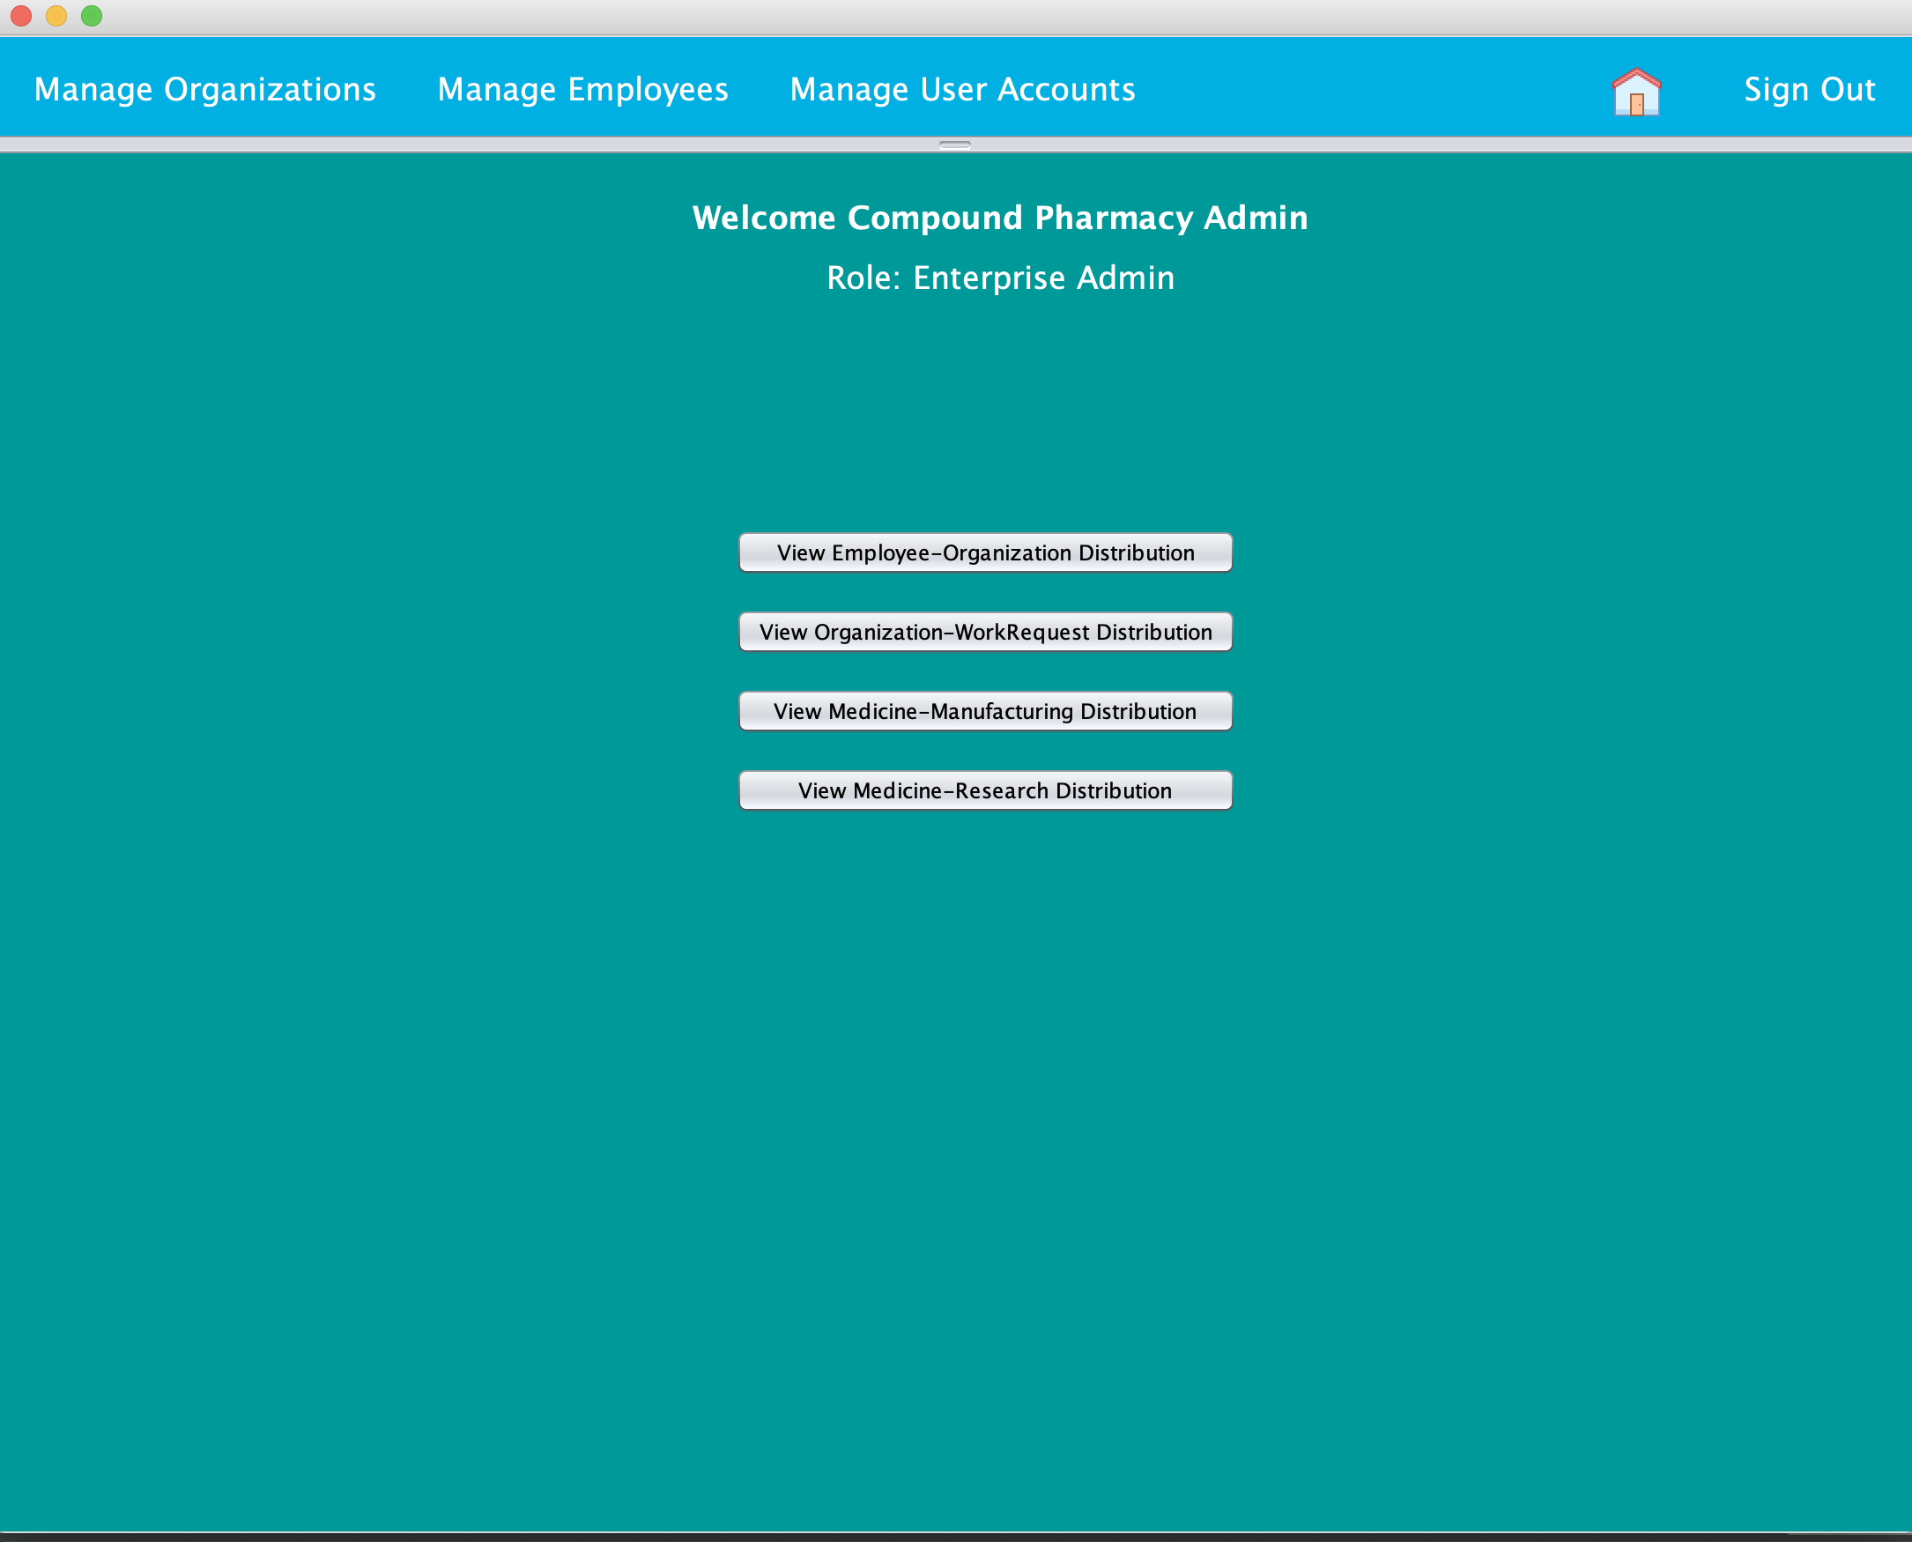
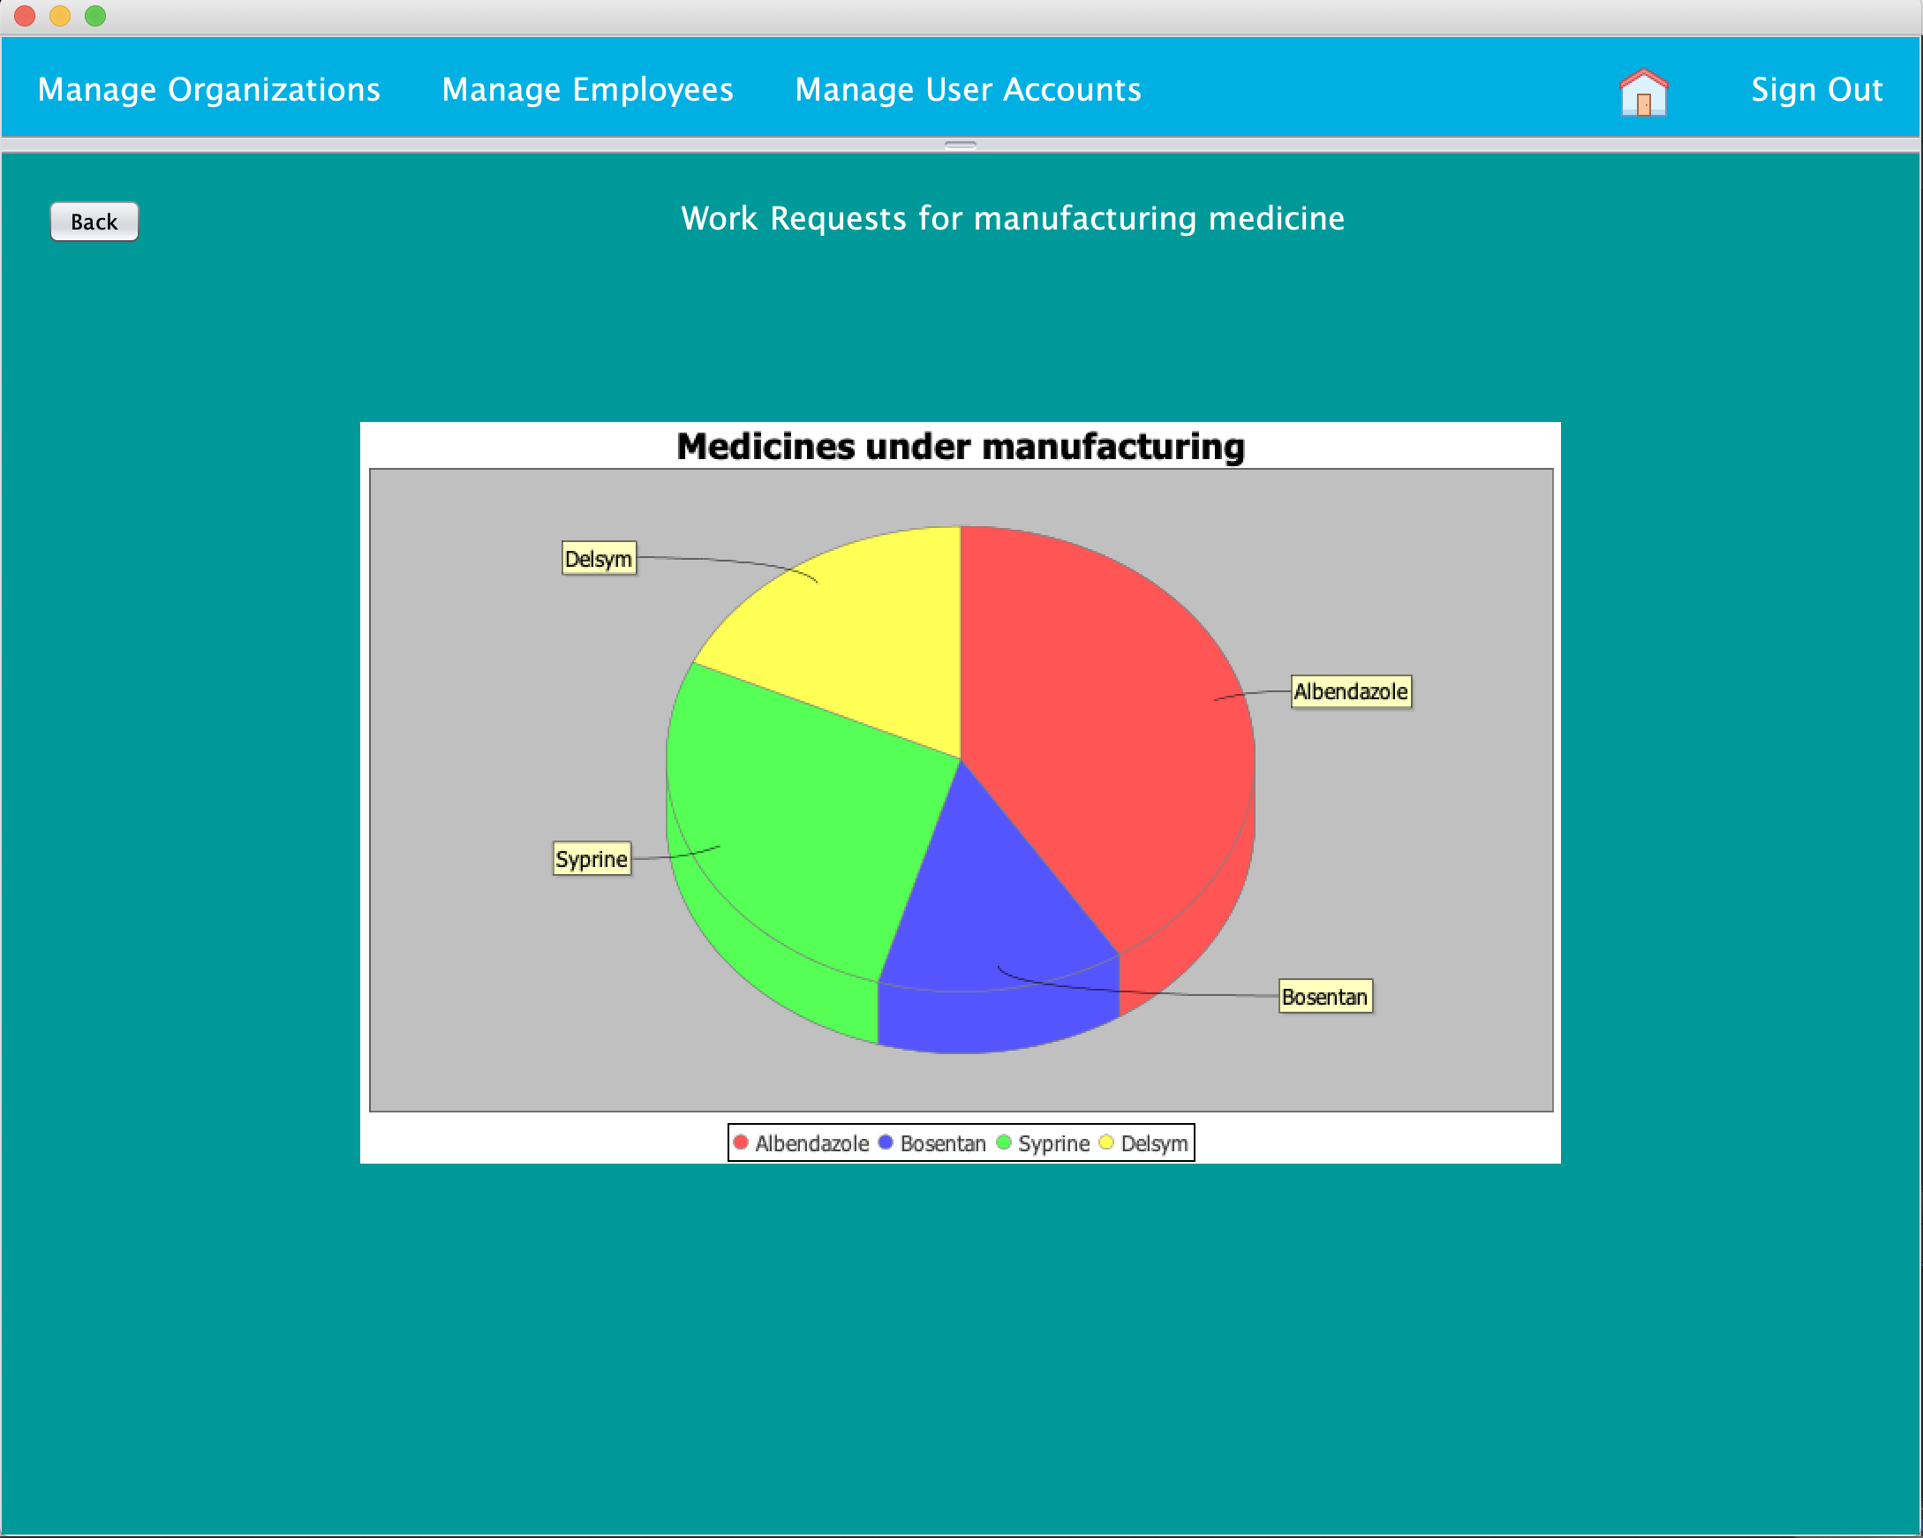

Slide 8
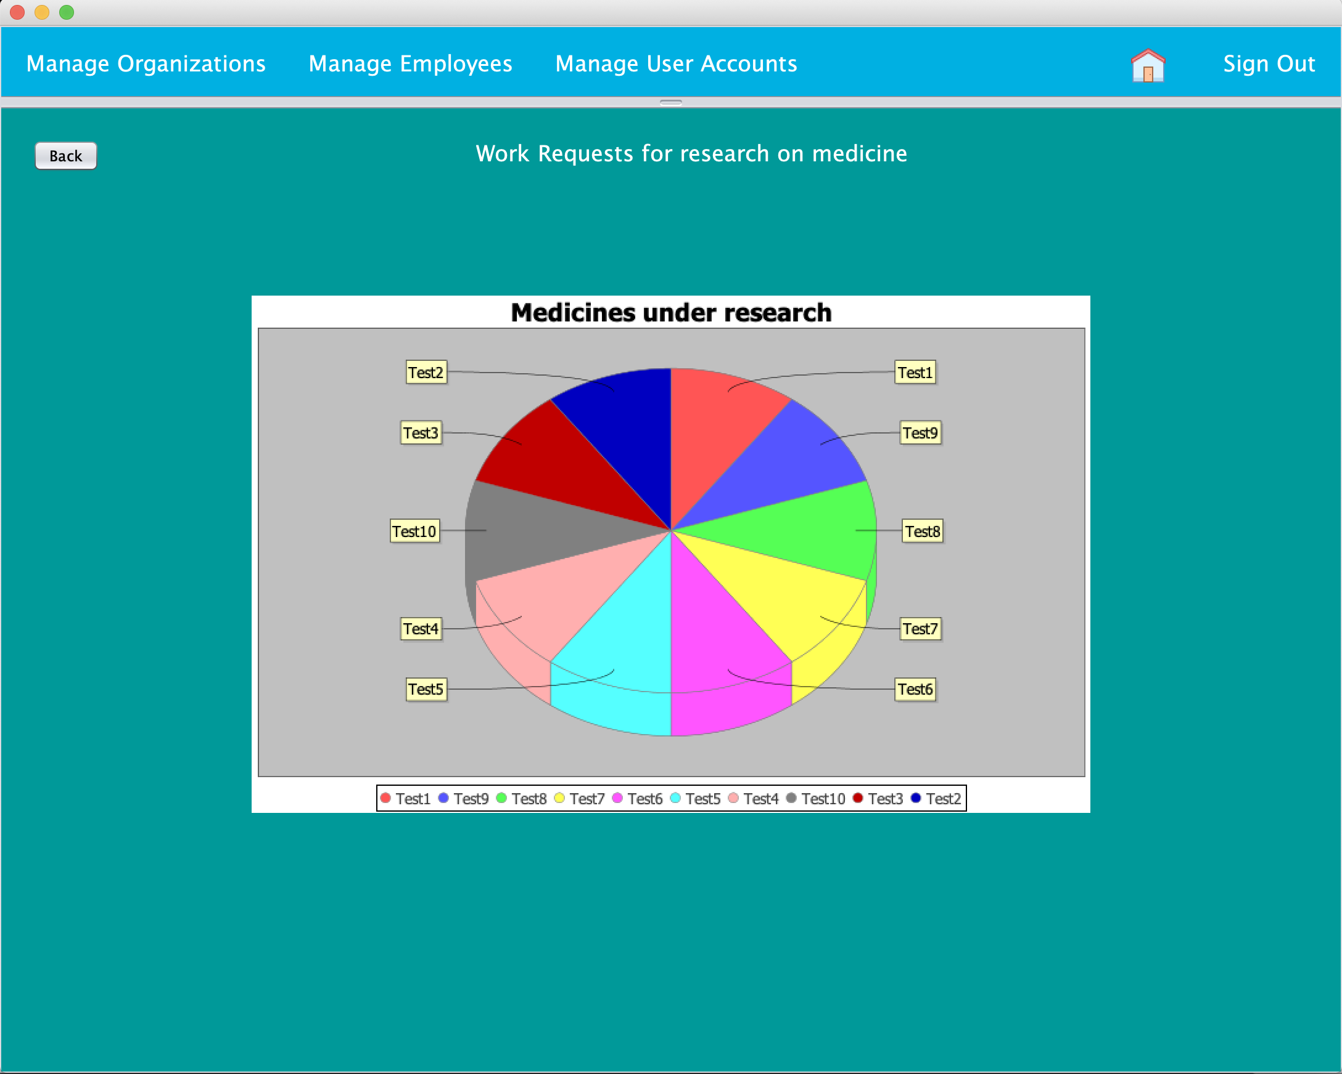
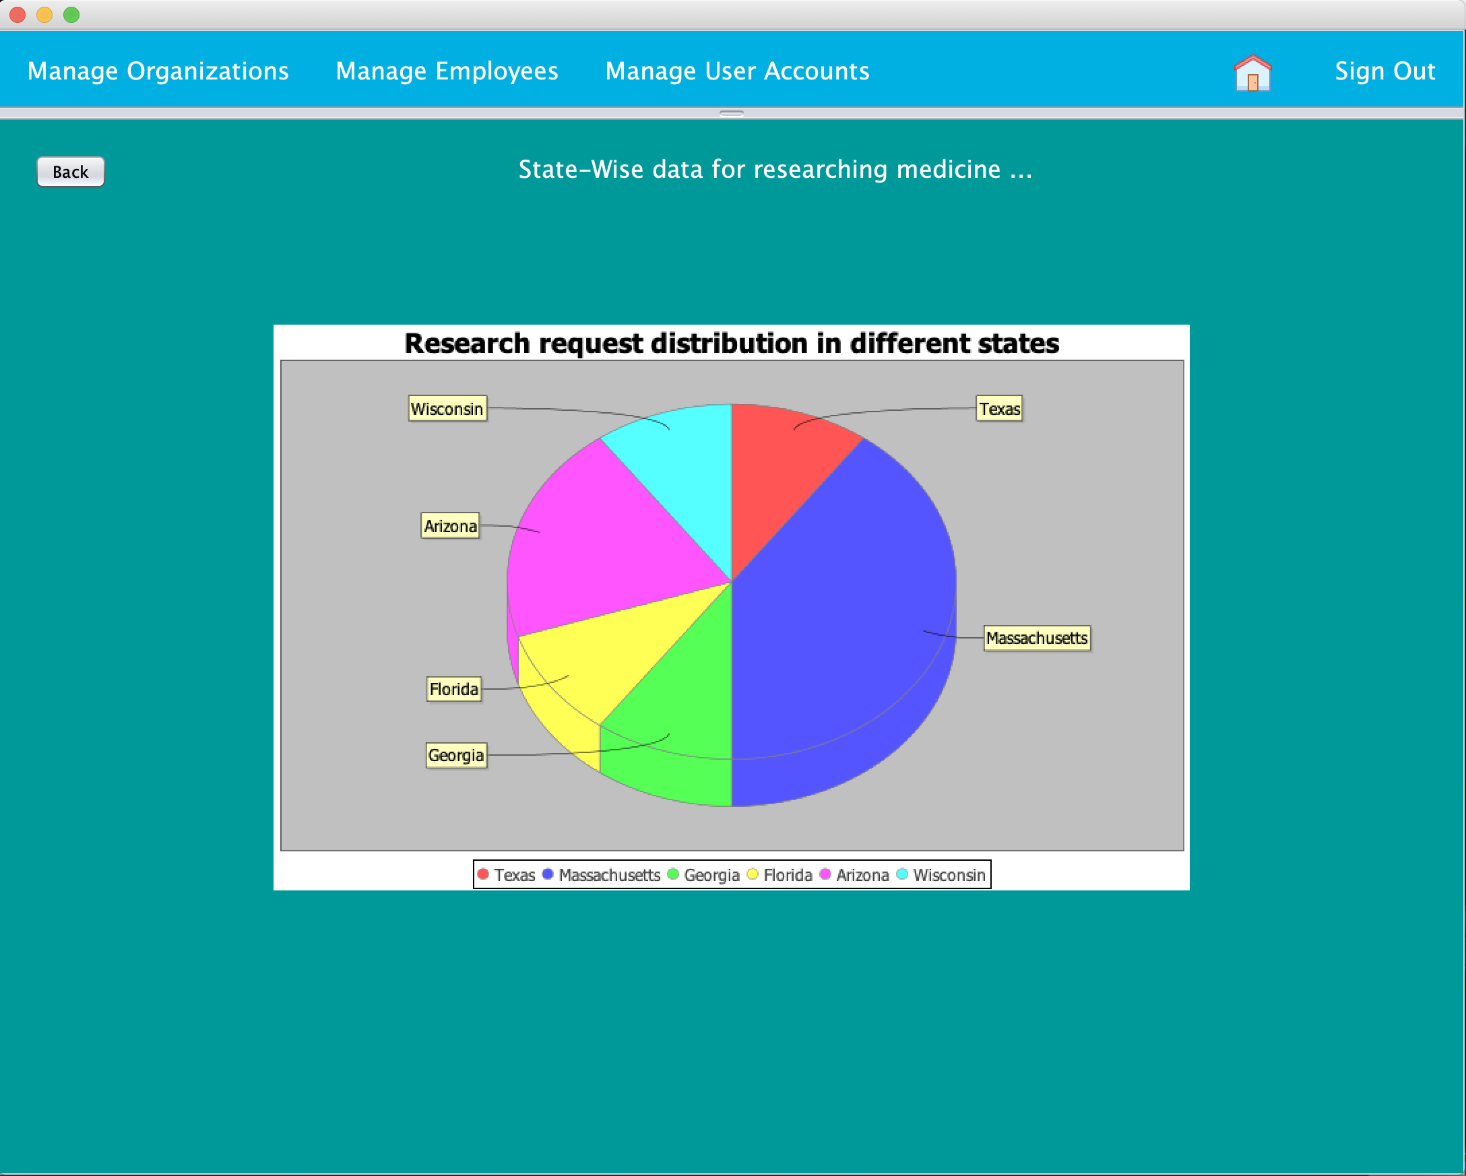

Slide 9
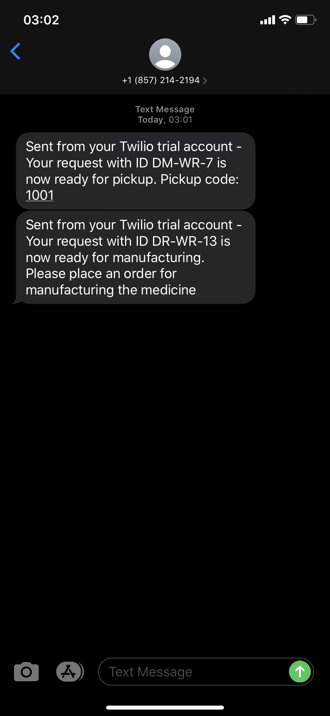

Slide 10
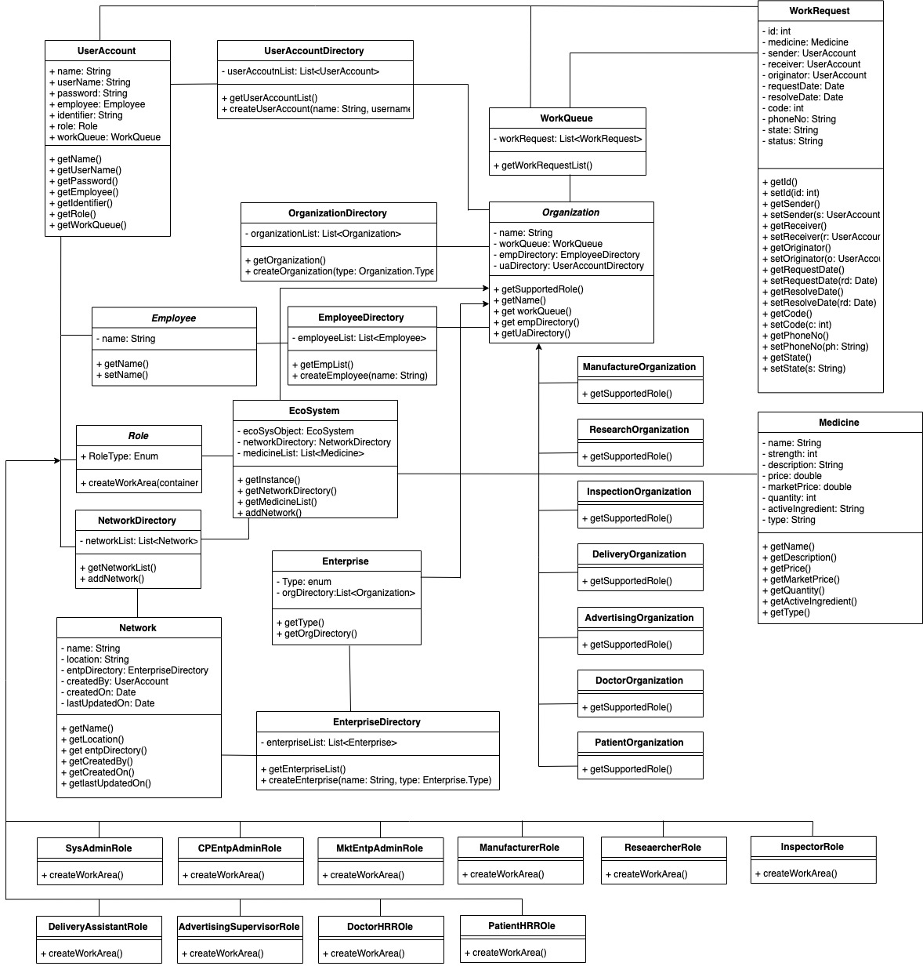
Class Diagram

